Slide 1

WEB TECHNOLOGIES
HTML – Forms
Vinay Joshi
Department of
Computer Science and Engineering

Slide 2
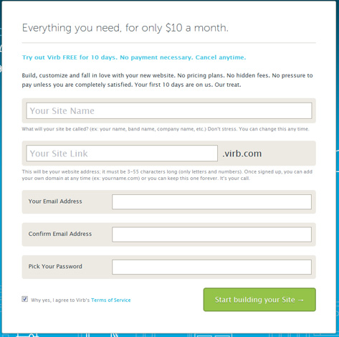
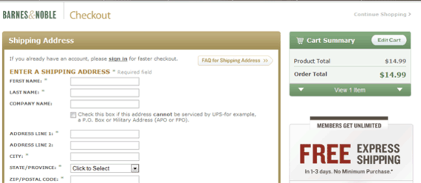
HTML – Forms
Introduction

Slide 3
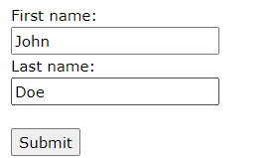
HTML – Forms
Introduction
An HTML form is used to collect user input.
A form is a way to send information from a browser to a server
All the components of a form appear as the content of <form> tag
The components are called widgets (e.g., text boxes, radio buttons and checkboxes)
A simple form may look like this:

Slide 4
HTML – Forms
Attributes
Syntax:
<form list_of_attributes_and_values>
<input element>
…
</form>
Important attributes of the <form> tag
Method
Action
Target
Example:
<form method=“post” action=“survey.php” target=“_blank”>
<input type=“text”>
…
</form>

Slide 5
HTML – Forms
Methods
GET:
Appends the form data to the URL, in name/value pairs
NEVER use GET to send sensitive data! (the submitted form data is visible in the URL!)
The length of a URL is limited (2048 characters)
Useful for form submissions where a user wants to bookmark the result
GET is good for non-secure data, like query strings in Google
POST:
Appends the form data inside the body of the HTTP request (the submitted form data is not shown in the URL)
POST has no size limitations, and can be used to send large amounts of data.
Form submissions with POST cannot be bookmarked

Slide 6
HTML – Forms
Input widgets
Input widget can be any of the following types
Text
Textarea
Button
Checkboxes
Radio Buttons
Dropdown list
Hidden

Slide 7
HTML – Forms
Input element
The HTML <input> element is the most used form element.
An <input> element can be displayed in many ways, depending on the type attribute.
Type | Description
<input type="text"> | Displays a single-line text input field
<input type="radio"> | Displays a radio button (for selecting one of many choices)
<input type="checkbox"> | Displays a checkbox (for selecting zero or more of many choices)
<input type="submit"> | Displays a submit button (for submitting the form)
<input type="button"> | Displays a clickable button

Slide 8
HTML – Forms
Introduction
action attribute specifies the URL of the application to be called when the Submit button is clicked (ex. action = http://www.cs.ucp.edu/cgi-bin/survey.pl)
no action, i.e. the value of action is the empty string or missing, then no request is sent on clicking the button
The method attribute of <form> specifies one of the two possible techniques of transferring the form data to the server, get and post
get and post are discussed in Chapter 10
Widgets
Many are created with the <input> tag
The type attribute of <input> specifies the kind of widget being created
Text
Creates a horizontal box for text input
Default size is 20; it can be changed with the size attribute
If more characters are entered than will fit, the box is scrolled (shifted) left

Slide 9
Forms (continued)
If you don’t want to allow the user to type more characters than will fit, set maxlength, which causes excess input to be ignored
<input type = "text" name = "Phone" size = "12" >
2. Checkboxes - to collect multiple choice input
Every checkbox requires a value attribute, which is the widget’s value in the form data when the checkbox is ‘checked’
A checkbox that is not ‘checked’ contributes no value to the form data
By default, no checkbox is initially ‘checked’
To initialize a checkbox to ‘checked’, the checked attribute must be set to "checked"

Slide 10
Forms (continued)
Grocery Checklist
<form action = "">
<p>
<input type = "checkbox" name ="groceries"
value = "milk" checked = "checked">
Milk
<input type = "checkbox" name ="groceries"
value = "bread">
Bread
<input type = "checkbox" name = "groceries"
value= "eggs">
Eggs
</p>
</form>

Slide 11
Forms (continued)
3. Radio Buttons
Radio buttons are used in a group. Only one element of a radio group can be selected at a time.
If no button in a radio button group is ‘pressed’, the browser often ‘presses’ the first one
Age Category Example:
<form action = "">
<p>
<input type = "radio" name = "age"
value = "under20" checked = "checked"> 0-19
<input type = "radio" name = "age"
value = "20-35"> 20-35
<input type = "radio" name = "age"
value = "36-50"> 36-50
<input type = "radio" name = "age"
value = "over50"> Over 50
</p>
</form>

Slide 12
Forms (continued)
4. Menus - created with <select> tags
There are two kinds of menus, those that behave like checkboxes and those that behave like radio buttons (the default)
Menus that behave like checkboxes are specified by including the multiple attribute, which must be set to "multiple"
The name attribute of <select> is required
The size attribute of <select> can be included to specify the number of menu items to be displayed (the default is 1)
If size is set to > 1 or if multiple is specified, the menu is displayed as a pop-up menu

Slide 13
Forms (continued)
Menus (continued)
Each item of a menu is specified with an <option> tag, whose pure text content (no tags) is the value of the item
An <option> tag can include the selected attribute, which when assigned "selected” specifies that the item is preselected
Grocery Menu - milk, bread, eggs, cheese
<form action = "">
<p>
With size = 1 (the default)
<select name = "groceries">
<option> milk </option>
<option> bread </option>
<option> eggs </option>
<option> cheese </option>
</select>
</p>
</form>

Slide 14
Forms (continued)
Widgets (continued)
After clicking the menu:
After changing size to 2:

Slide 15
Forms (continued)
5. Text areas - created with <textarea>
Usually include the rows and cols attributes to specify the size of the text area
Default text can be included as the content of <textarea>
Scrolling is implicit if the area is overfilled
Please provide your employment aspirations
<form action = "">
<p>
<textarea name = "aspirations" rows = "3”
cols = "40">
(Be brief and concise)
</textarea>
</p>
</form>

Slide 16
Forms (continued)
6. Reset and Submit buttons
Both are created with <input>
<input type = "reset" value = "Reset Form">
<input type = "submit” value = "Submit Form">
Submit has two actions:
Encode the data of the form
Request that the server execute the server-resident program specified as the value of the action attribute of <form>
A Submit button is required in every form

Slide 17
HTML – Forms
HTML5 – New Input widgets
HTML5 specifications introduced new Input types
email : email address
number: spinbox
range: slider
url: web addresses
color: color pickers
search: search boxes
date: date
month: month
time: time
week: week
datetime: combination of date and time.

Slide 18
HTML5: Input - e-mail
The email type is used for input fields that should contain an e-mail address.
The value of the email field is automatically validated when the form is submitted.
E-mail: <input type="email" name="user_email" />

Slide 19
HTML5: Input - url
The url type is used for input fields that should contain a URL address.
The value of the url field is automatically validated when the form is submitted.
Homepage: <input type="url" name="user_url" />

Slide 20
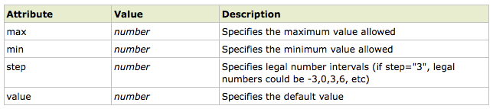
HTML5: Input - number
The number type is used for input fields that should contain a numeric value.
Set restrictions on what numbers are accepted:
Points: <input type="number" name="points" min="1" max="10" />

Slide 21
HTML5: Input - range
The range type is used for input fields that should contain a value from a range of numbers.
The range type is displayed as a slider bar.
You can also set restrictions on what numbers are accepted:
<input type="range" name="points" min="1" max="10" />

Slide 22
HTML5: Input – date pickers
HTML5 has several new input types for selecting date and time:
> date - Selects date, month and year
> month - Selects month and year
> week - Selects week and year
> time - Selects time (hour and minute)‏
> datetime - Selects time, date, month and year. This is now obsolete
> datetime-local - Selects time, date, month and year (local time)‏

Slide 23
HTML5: Input - search
HTML5: Input - search
The search type is used for search fields like a site search or Google search.
The search field behaves like a regular text field.

Slide 24
HTML5: Input – color picker
HTML5: Input – color picker
The color type is used for input fields that should contain a color.
This input type will allow you to select a color from a color picker:
Color: <input type="color" name="user_color" />

Slide 25
Id attribute and name attribute
The name attribute is commonly used in form elements (like <input>, <select>, <textarea>, etc.) to define the name that is sent to the server when the form is submitted. This name is used to identify the value associated with the form element.
The id attribute is used to uniquely identify elements for styling and JavaScript purposes.
The name attribute is used to identify form elements and send their values to the server when a form is submitted.

Slide 26
Label element
<label for="fname" >First Name:
<input type="text" name="name" id="fname">
</label>
Label html element represents a caption for an item. Used to associate text with an input element.
For attribute specifies which form element a label is bound to.It is set to id of input element

Slide 27
<label for="fname" >First Name:
<input type="text" name="name" id="fname"> <br><br>
</label>

Slide 28
THANK YOU
Vinay Joshi
Department of Computer Science and Engineering
vinayj@pes.edu
+91 80 2672 6622

